Slide 1
High Waters Need Strong Bridges
Why and How Scientists Can Collaborate as Climate Changes
Brooke Anderson, PhD
Associate Professor, Department of Radiological & Environmental Health Sciences, Colorado State University

Slide 2
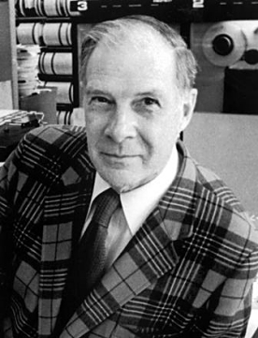
Richard Hamming
“You and Your Research”
“For some years I set aside Friday afternoons for ‘great thoughts’. Of course, I would answer the telephone, sign a letter, and such trivia, but essentially, once lunch started, I would only think great thoughts—what was the nature of computing, how would it affect the development of science, what was the natural role of computers in Bell Telephone Laboratories, what effect will computers have on AT&T, on science generally?”

Slide 3
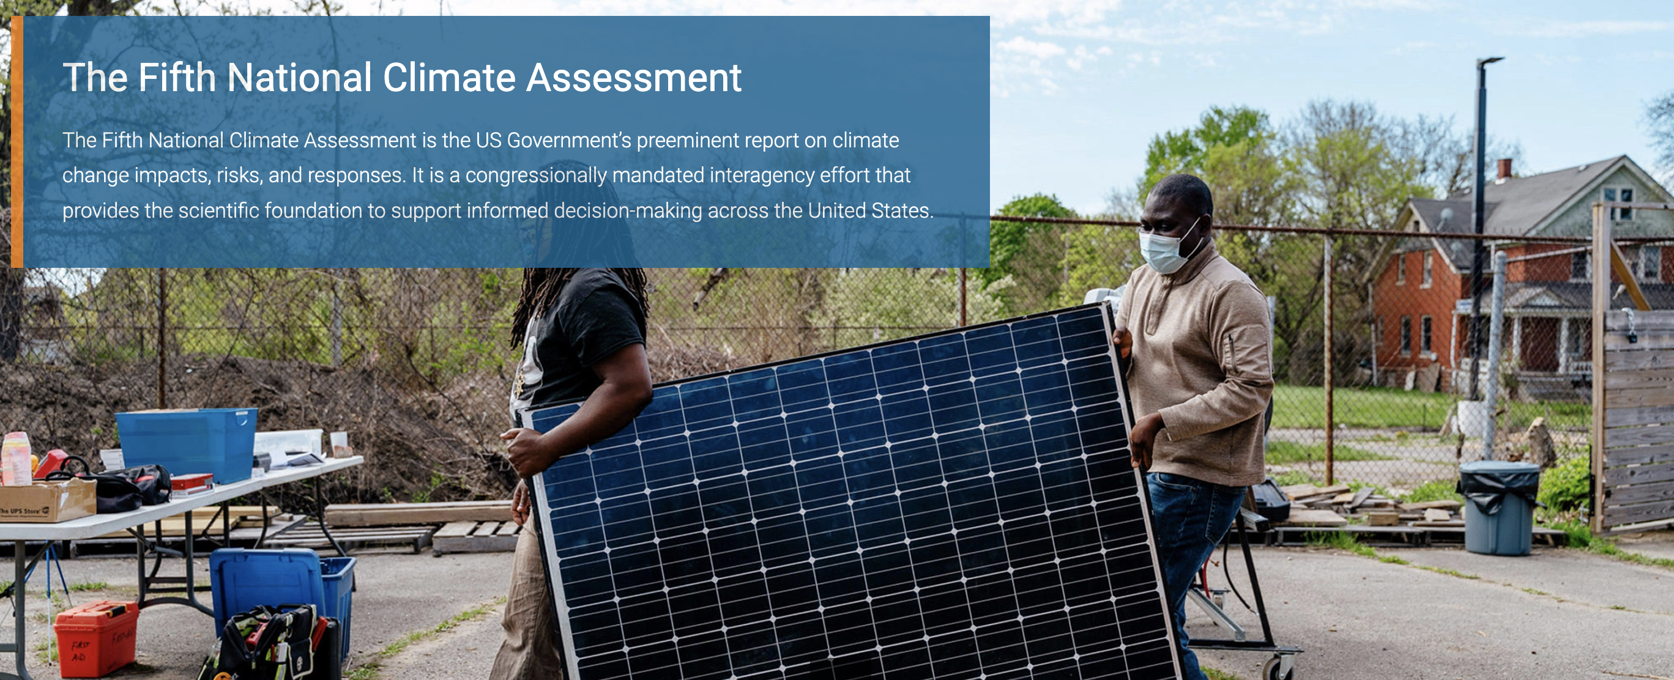
Hamming’s question
“What are the most important problems in your field?”

Slide 4
The 1900 Galveston Hurricane
Tragedy and progress in the 20th Century

Slide 5
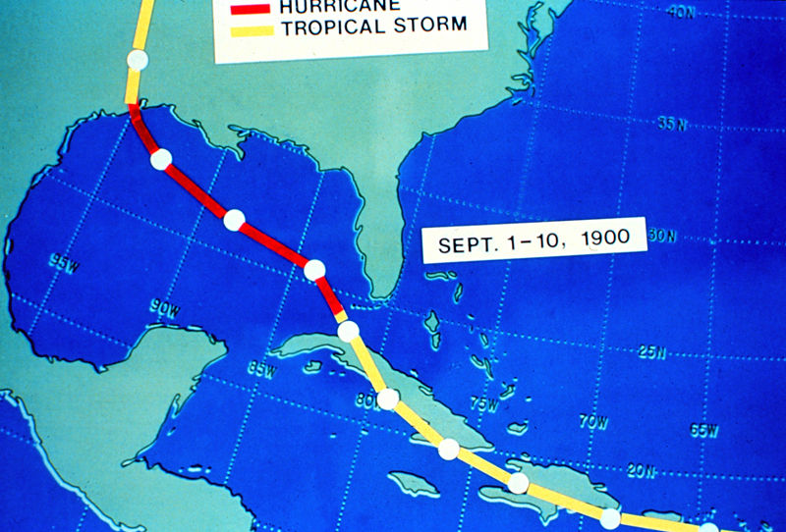
1900 Galveston Hurricane
Deadliest natural disaster in US history
Source: NOAA
Notes:
Thought it was going a different direction after Cuba
Little / no warning

Slide 6
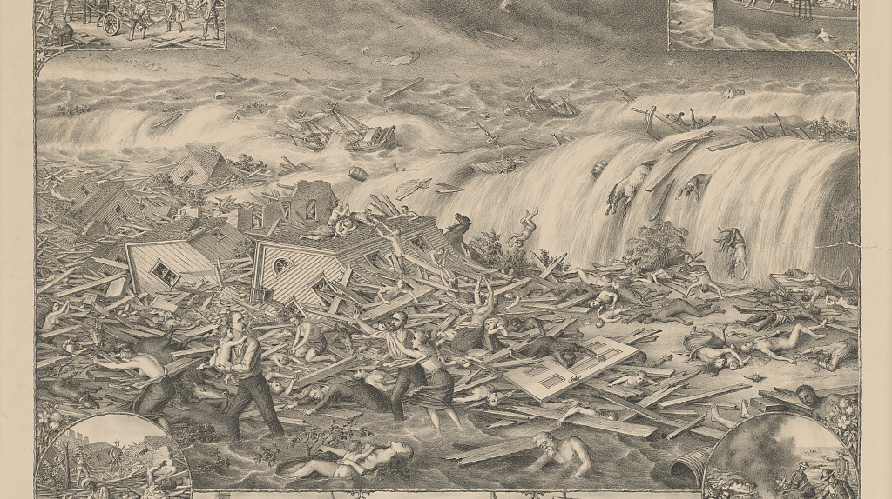
Source: Kurz & Allison
Notes:
Galveston's awful calamity - Gulf tidal wave, September 8th 1900
Kurz & Allison
”Print shows the destruction caused by a hurricane and tidal wave to Galveston, Texas, wreckage to buildings, survivors, and the bodies of victims; also shows vignettes at the corners and across the bottom: Drays employed carrying the bodies to barges for burial in the Gulf (top left), 2650 dead bodies burried [sic] in the Gulf (top right), Bodies incinerated in lieu of burial (bottom right), Shooting ghouls, found despoiling the dead (bottom left), and at center, View of ruins, Avenue "L" west, Ruins of Sacred Heart Church, cor 13' & Broadway, and First Baptist Church ruins, cor. 22' & Winnie st’s.”

Slide 7
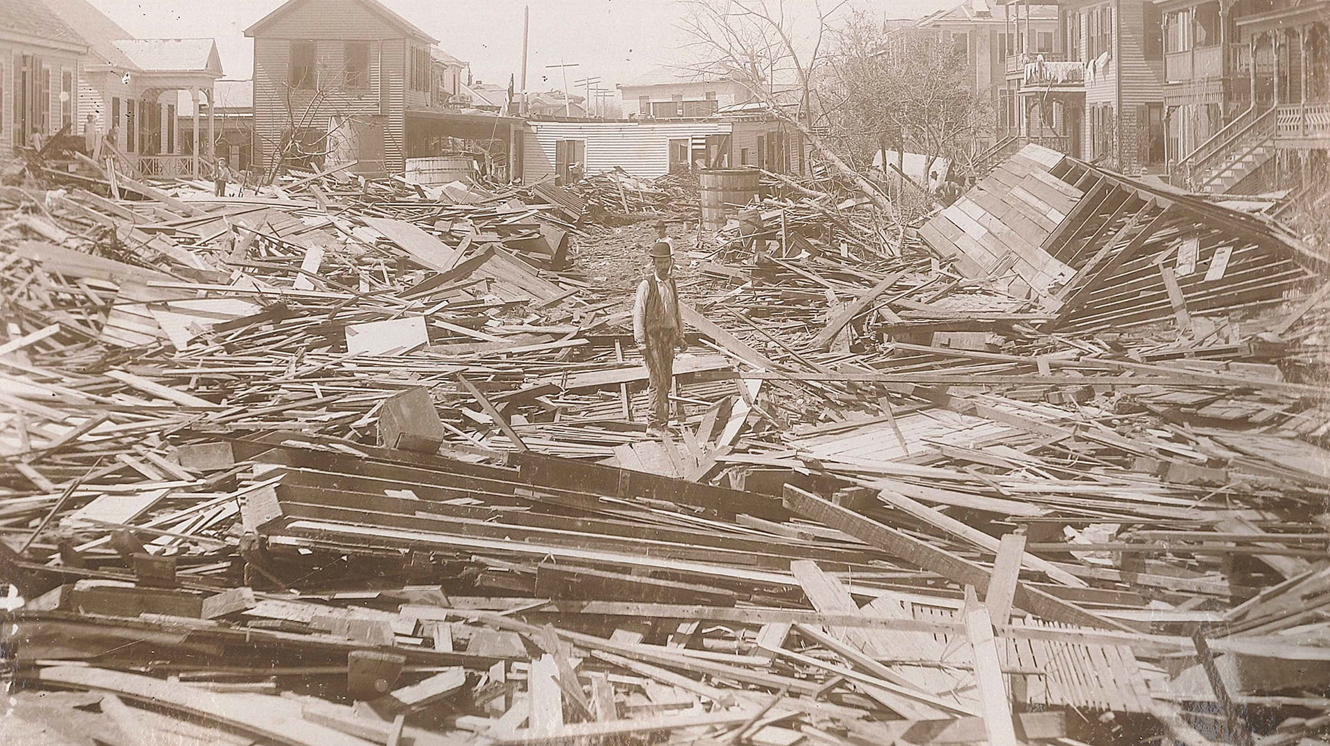
Source: Library of Congress
Notes:
Storm surge of 8 to 12 ft, highest point about 9 ft

Slide 8
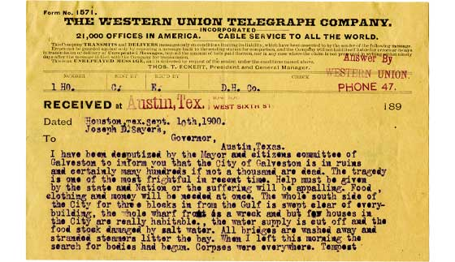
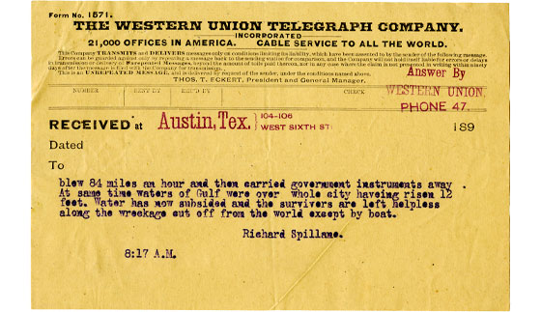
Source: Bullock Museum

Slide 9
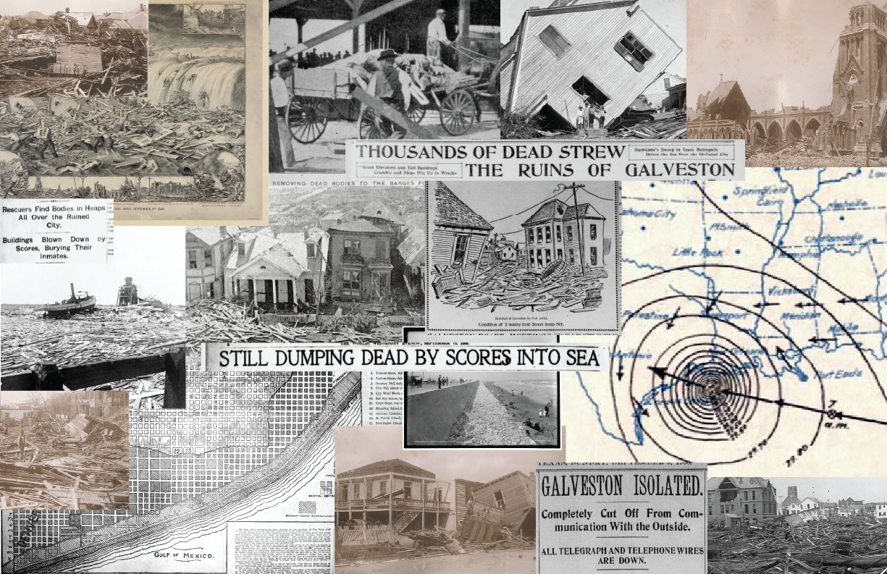
Notes:
Deadliest natural disaster in US history: 6,000 to 12,000 deaths
Galveston’s total population at the time: < 38,000

Slide 10
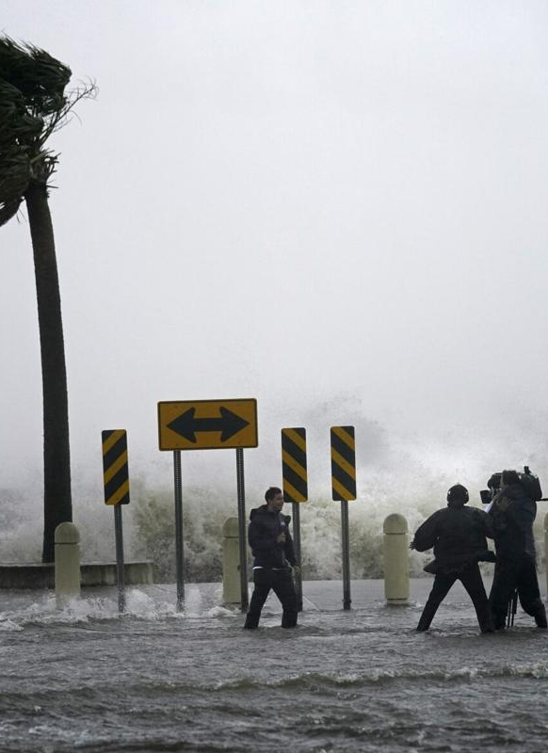
Forewarning
Knowing the Storm is coming
“The first rule of hurricane coverage is that every broadcast must begin with palm trees bending in the wind.”
— Carl Hiaasen
Telegram to Galveston the day before the storm:
“High northerly winds tonight and Saturday with probably heavy rain”

Slide 11
Tracking the storm
The 1900 Galveston hurricane
Once the storm left Cuba, the US Weather Bureau wasn’t sure where it was
They thought the storm had turned toward Florida and issued warnings for the Atlantic coast

Slide 12
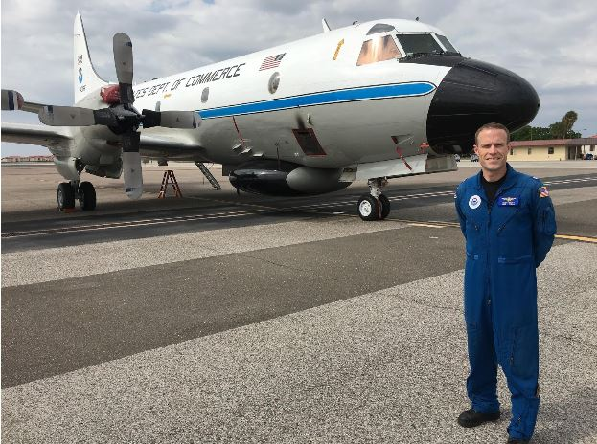
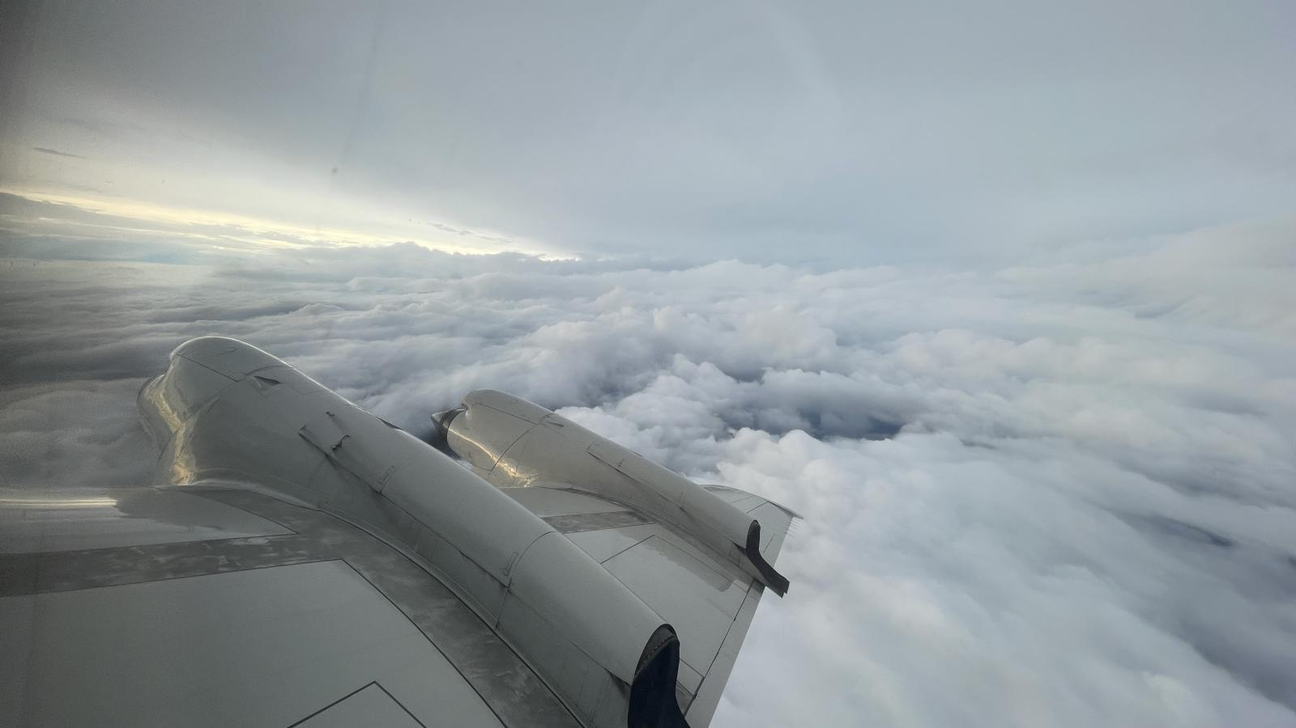
Flying the Storm
NOAA Hurricane Hunters
Source: NOAA
Notes:
Regularly since 1940s

Slide 13
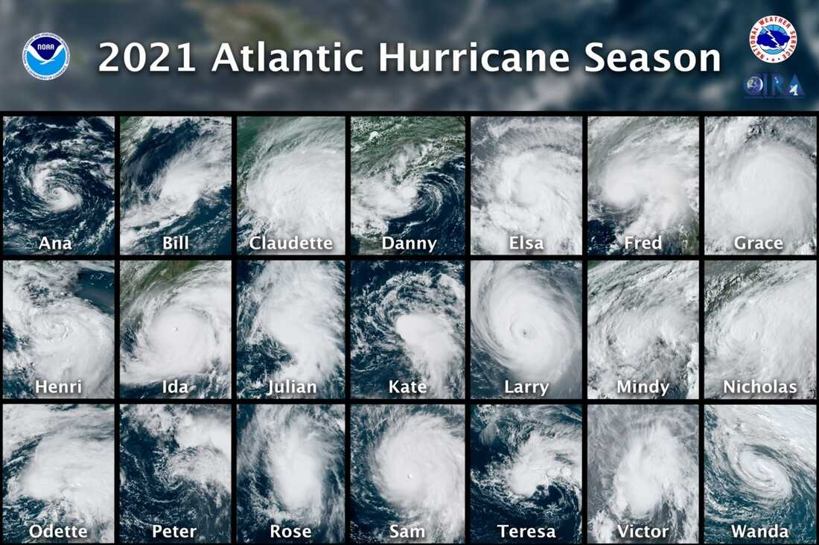
Source: NOAA, GOES East Satellite
Notes:
Season with 21 named storms
First satellite, 1961
Radar fence along Gulf and Atlantic coasts by 1960

Slide 14
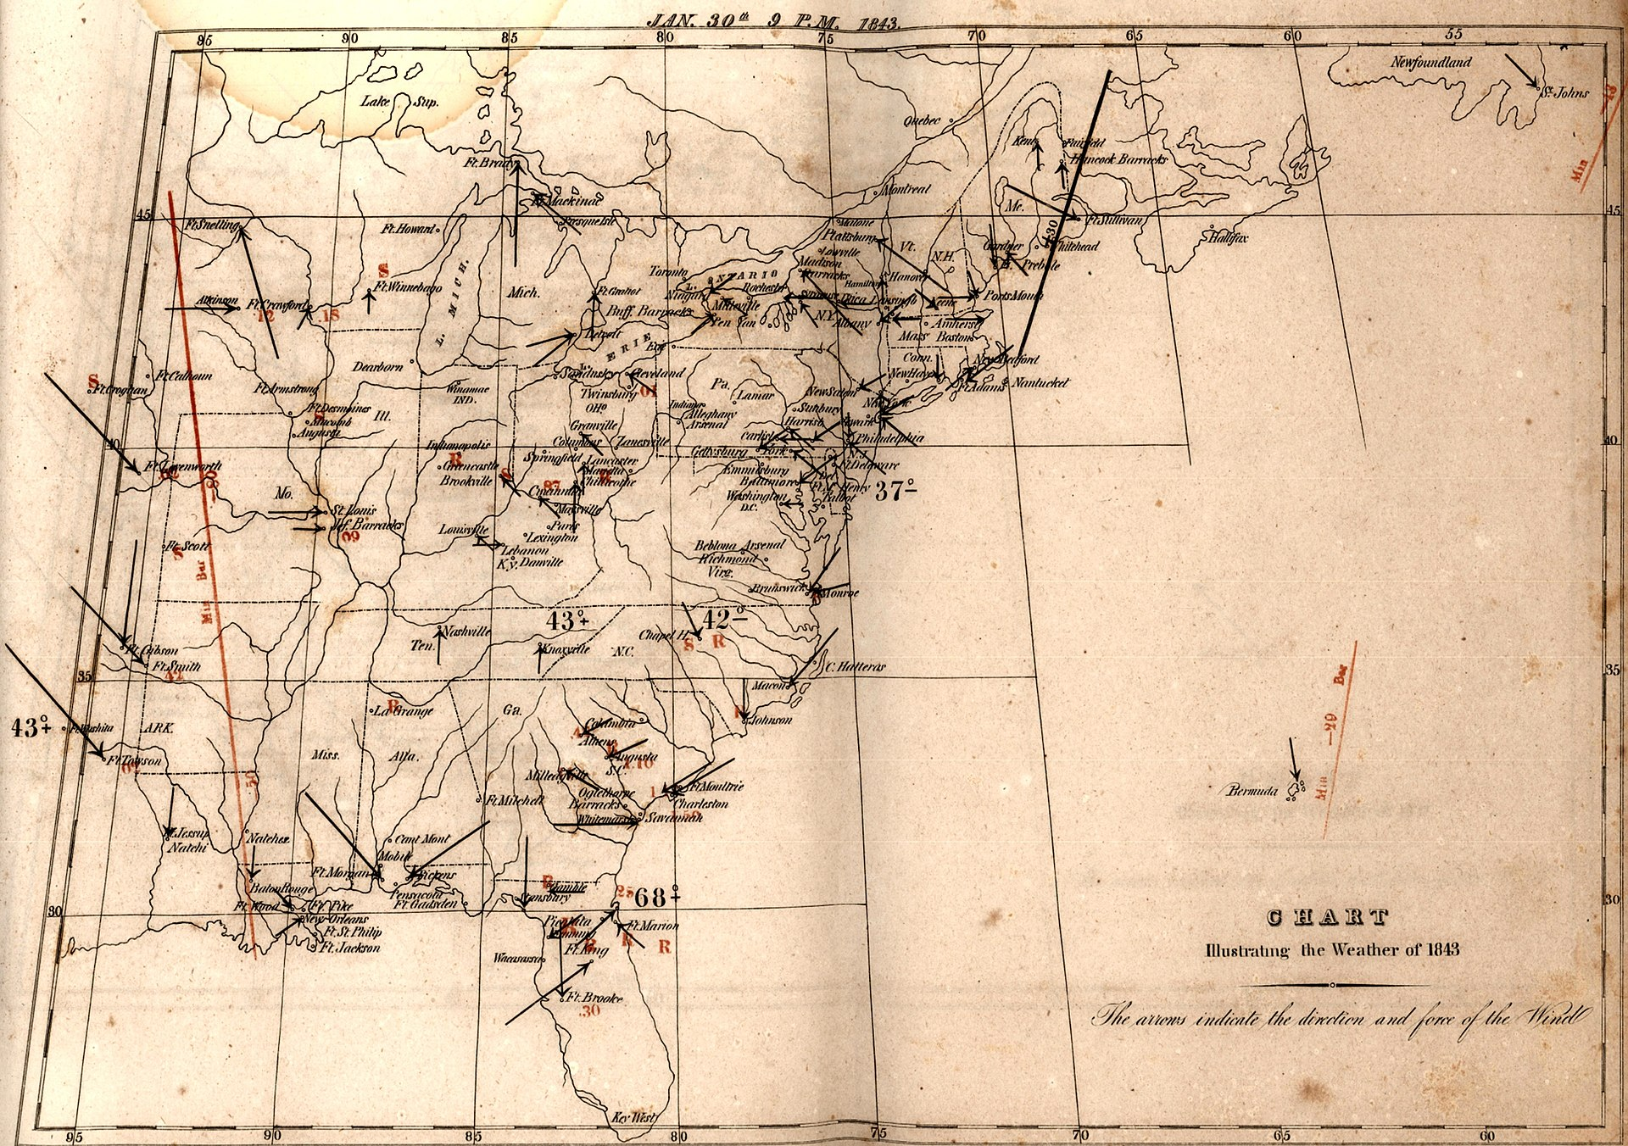
Forecasting
Predicting where the storm will go
Source: WBNG
Notes:
In 1898 the Weather Bureau established a hurricane warning network in the Caribbean. Experiments in wireless telegraphy (radio) were started in January 1900, initially under the direction of Canadian inventor Reginald Fessenden. Beginning in 1905, wireless weather reports from ships at sea were received.
…
In general, forecasts were telegraphed out within 2 or 3 hours of the observations having been made. In 1901, three day forecasts were begun for the North Atlantic.
https://www.analogweather.com/--us-nws-history.html

Slide 15
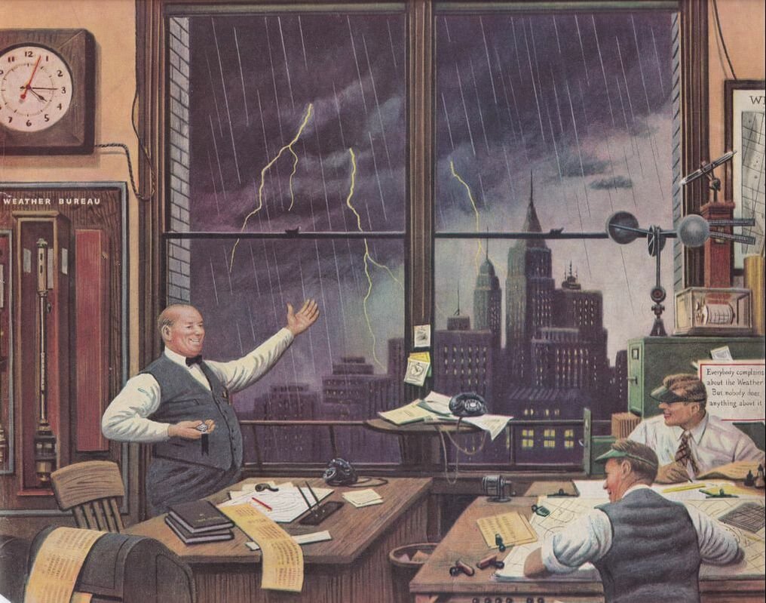
Source: Saturday Evening Post
1946

Slide 16
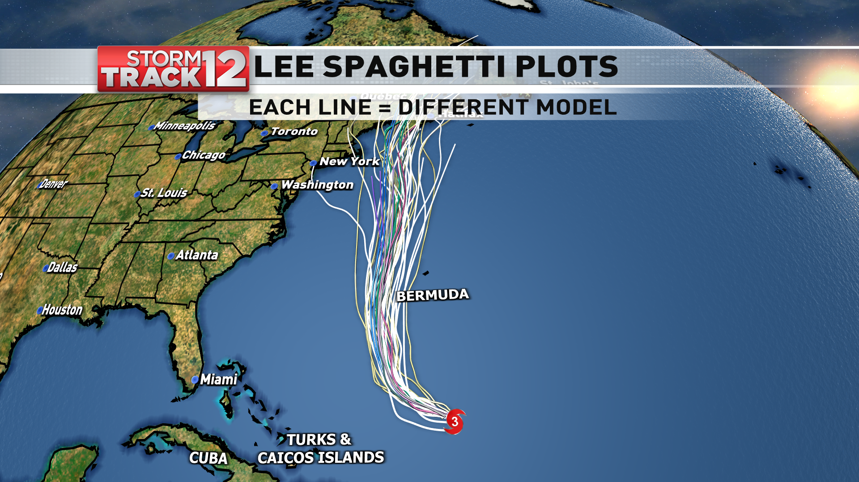
Forecasting
Predicting where the storm will go
Source: WBNG

Slide 17
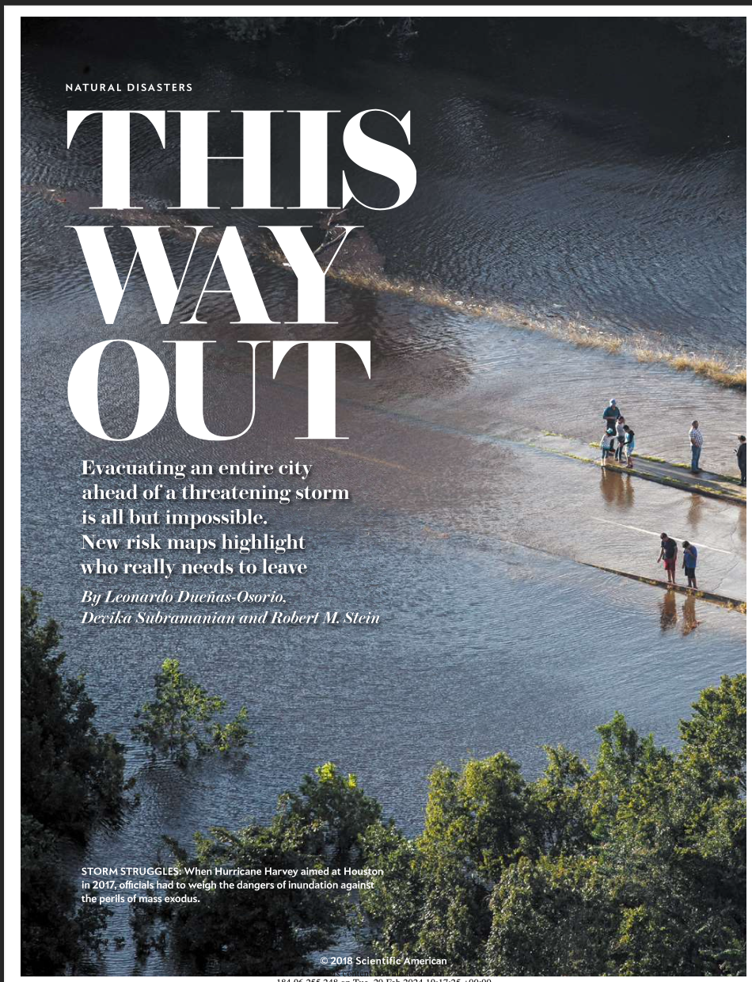
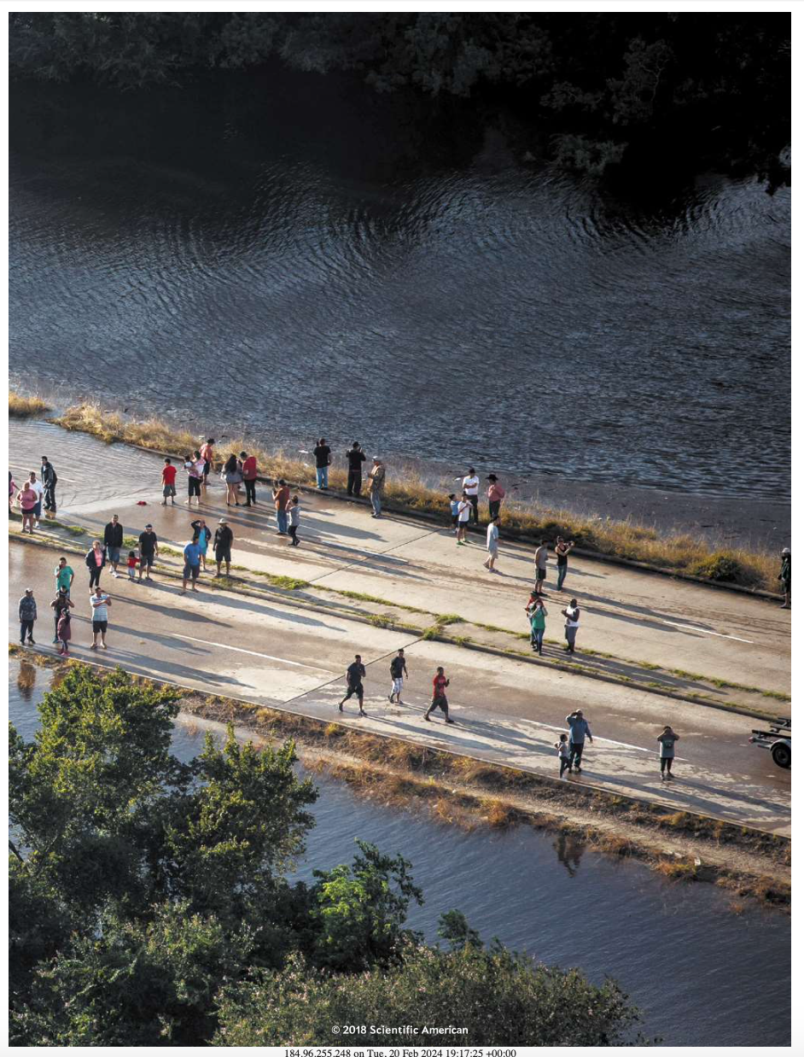
Source: Scientific American

Slide 18
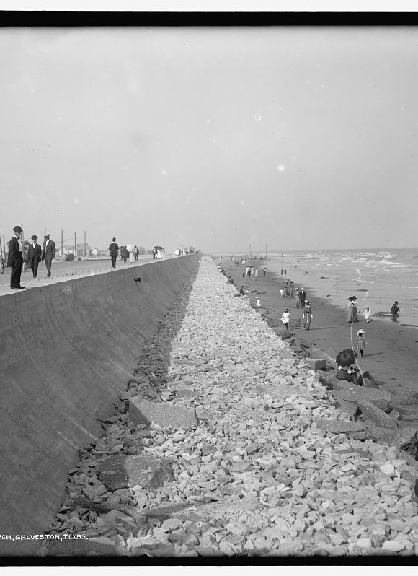
Engineering for storms
Hardening infrastructure
After the storm, Galveston built a seawall to protect against future storm surge.
The seawall is about 17 feet tall and currently more than 10 miles long.

Slide 19
Tips for Collaborating
Lessons Learned in Creating Strong and Effective Interdisciplinary Collaboration

Slide 20


Slide 21
Richard Hamming
“You and Your Research”
“Working with one’s door closed lets you get more work done per year than if you had an open door, but I have observed repeatedly that later those with the closed doors, while working just as hard as others, seem to work on slightly the wrong problems, while those who have let their door stay open get less work done but tend to work on the right problems!”
Notes:
Mathematician, Los Alamos, Bell Labs, 3rd Turing Award recipient
Hamming code, hamming difference
“You and Your Research”
Bellcore, 7 March, 1986

Slide 22
Tip #1: Prototype
Iterate and refine. Share prototypes early and often.

Slide 23
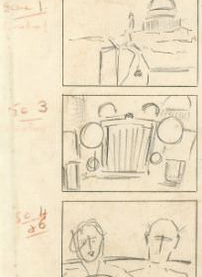
Prototyping for movies
Coordinating across a vast crew
Director
Cinematographer
Camera operators
Gaffer and lighting department
Grips
Sound production
Art department
Set designer
Prop department
Costume department
Hair and make-up
Special effects

Slide 24
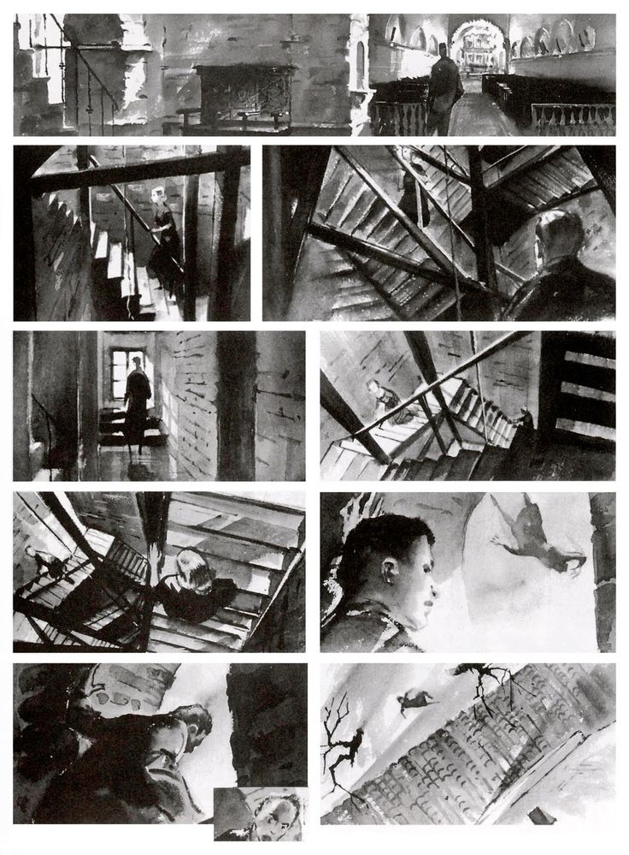
Storyboards
Allowing the whole team to plan
Extract the vision from the director’s head and get it where everyone can see it
Plan across the teams: camera angles, lighting
Allows teams to work in parallel

Slide 25
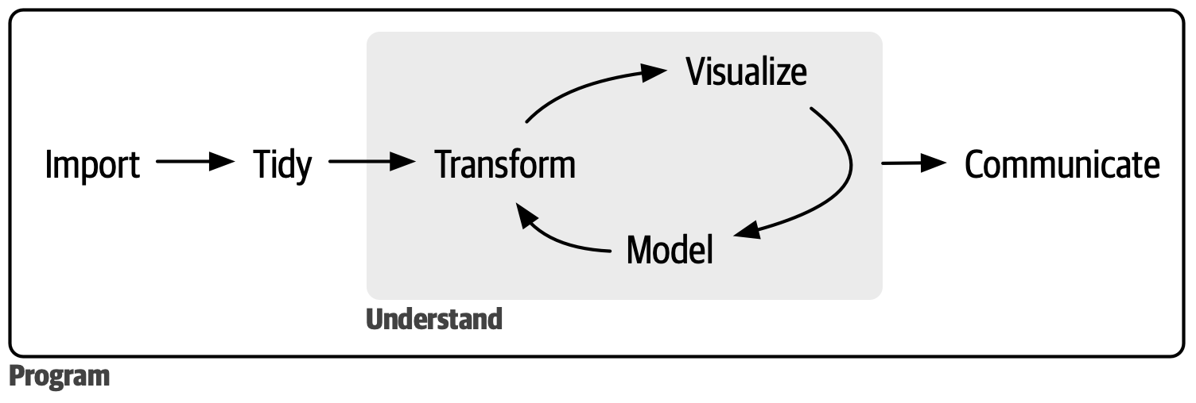
Prototyping in data science
Iterating in model development
Source: R for Data Science, Wickham et al.

Slide 26
Determining exposure to tropical cyclones
Measuring association between exposure and risk to health

Slide 27
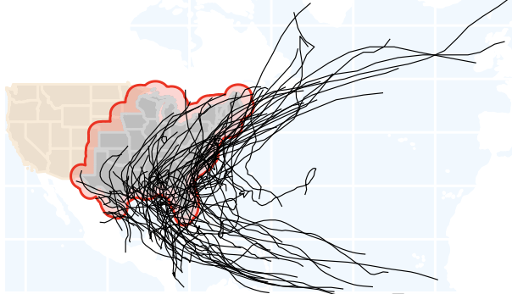

Slide 28
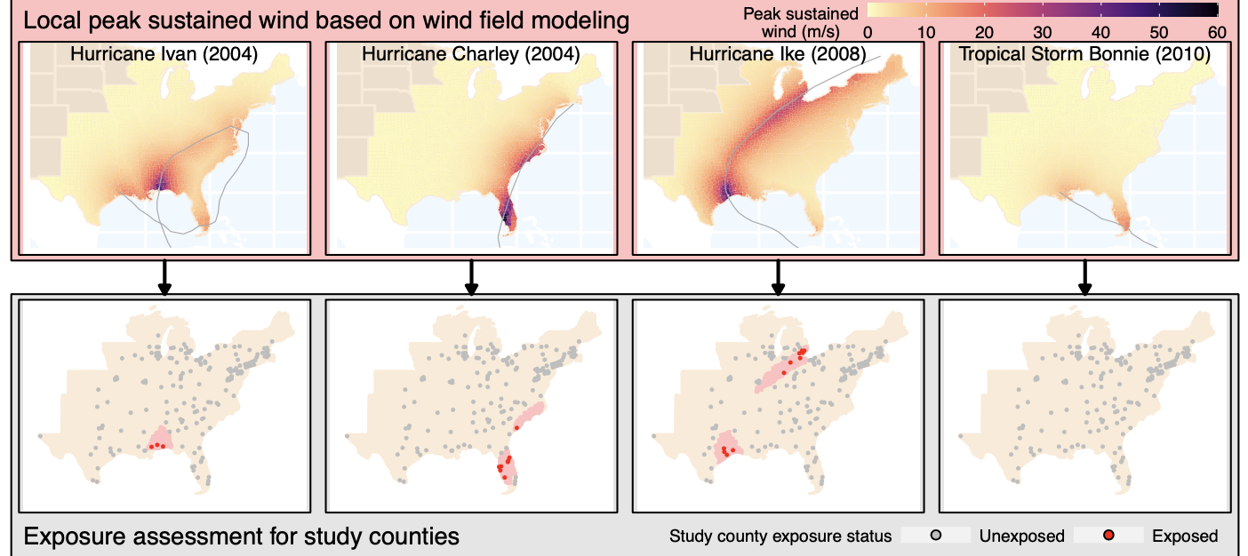
Prototyping in interdisciplinary projects
Starting with single storms, working up to a larger scale
Notes:
Iterating
Simple pipeline to start (one city, one storm)
Let’s everyone “see” a first version of ”the thing”
Identify and address issues (from all disciplines) early
Allows teams to work in parallel
Idea that a prototype should be almost early enough to be embarrassed by it: Others are more likely to give good advice on something that doesn’t seem polished
Markdown documents: Easy to add to and re-run, allows you to create an early simpler version and develop it into something larger

Slide 29
Tip #2: Organize in modules and interfaces
Coordinate connections. Create space for each expert to do their thing.

Slide 30
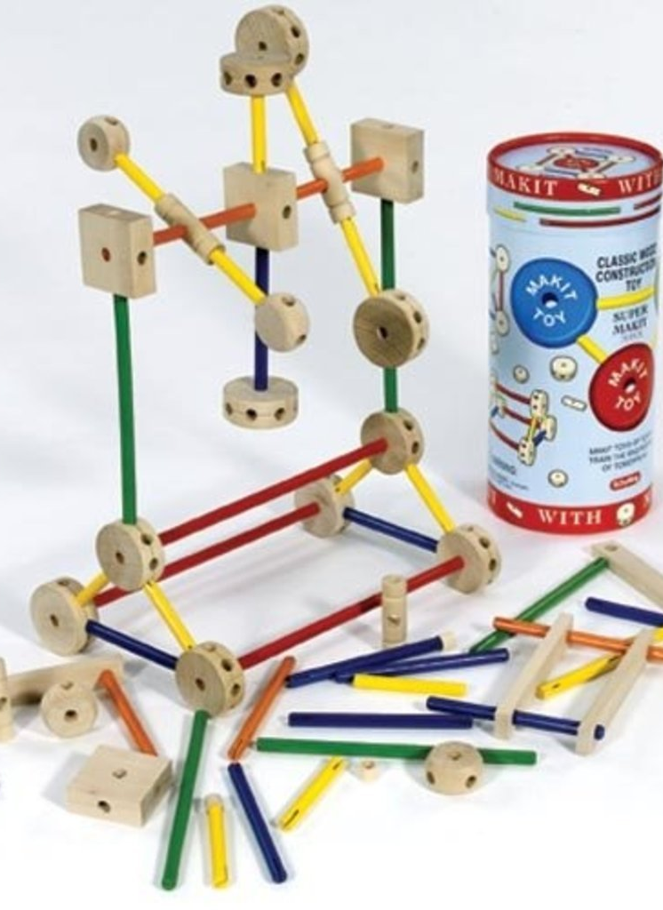
Modules and interfaces
The secret of great toys
Pieces connect to each other
Can be combined in infinite ways
Interface is often identical across pieces (pegs in Legos, holes in Tinker Toys)

Slide 31
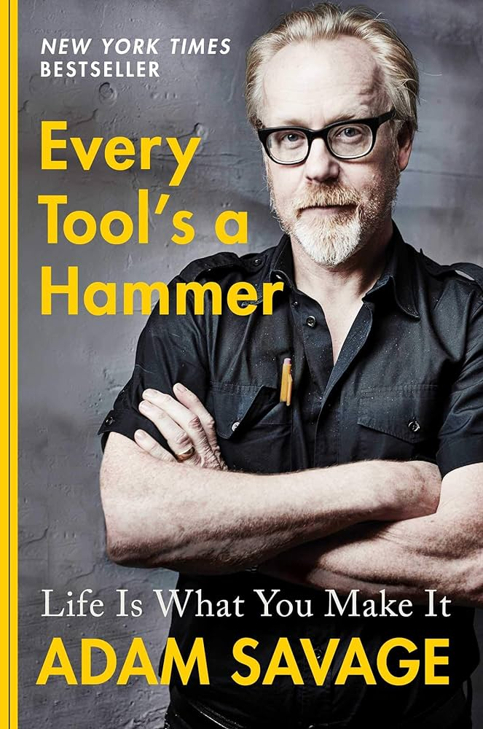
Modular building
Making pieces that go together
“You have to give everyone complete autonomy within a narrow bandwidth.” — Guillermo del Toro
“What he meant was that after you get buy-in on the larger vision, you need to strictly define their roles in the fulfillment of that vision, and then you need to set them free to do their thing.” — Adam Savage

Slide 32
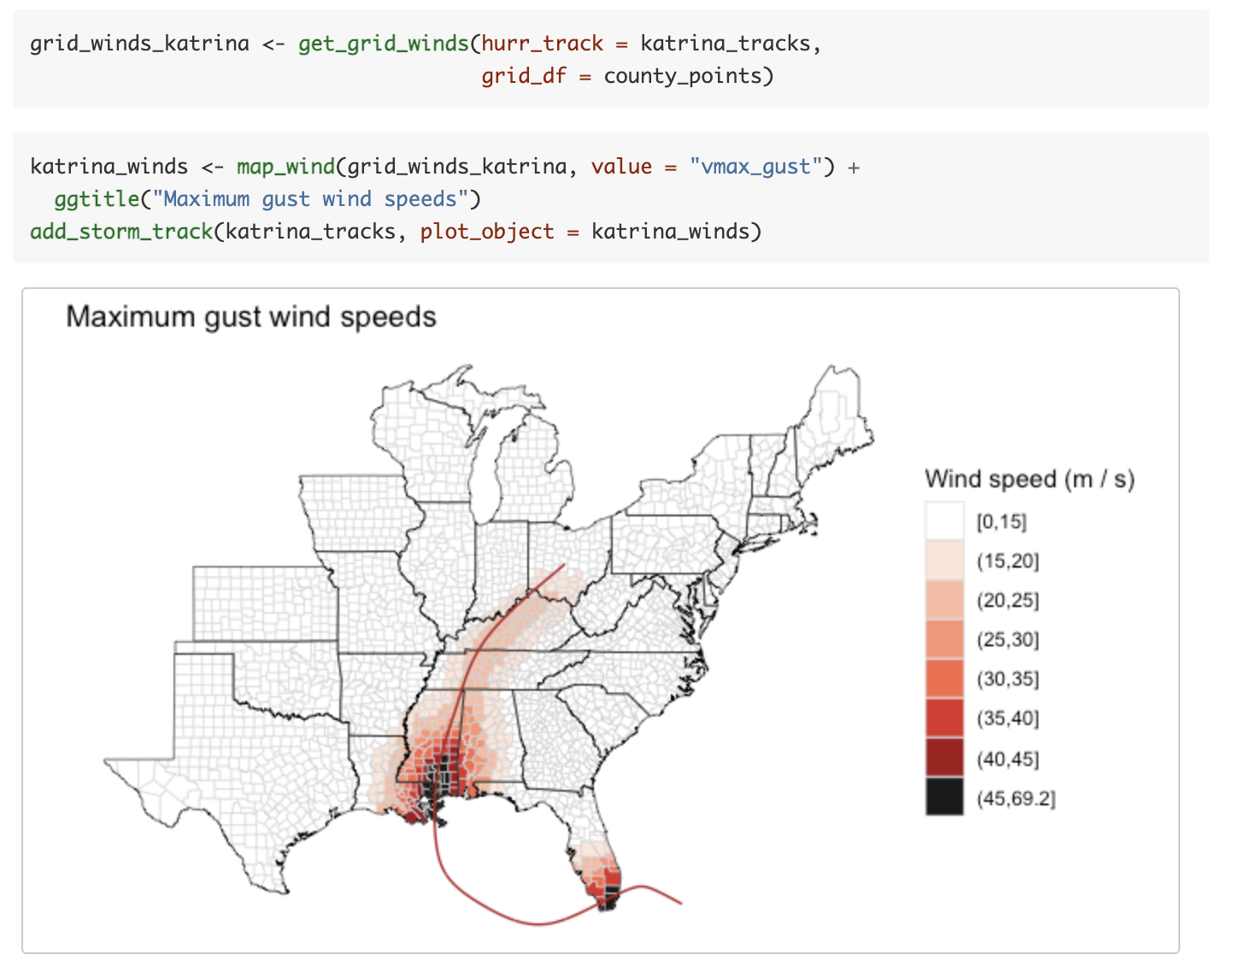
Determining exposure to tropical cyclones
Measuring association between exposure and risk to health
Interface:
Local wind speeds for each tropical cyclone in the study period
Estimated at the center of each study county
Ideally, recorded and shared in a certain format

Slide 34
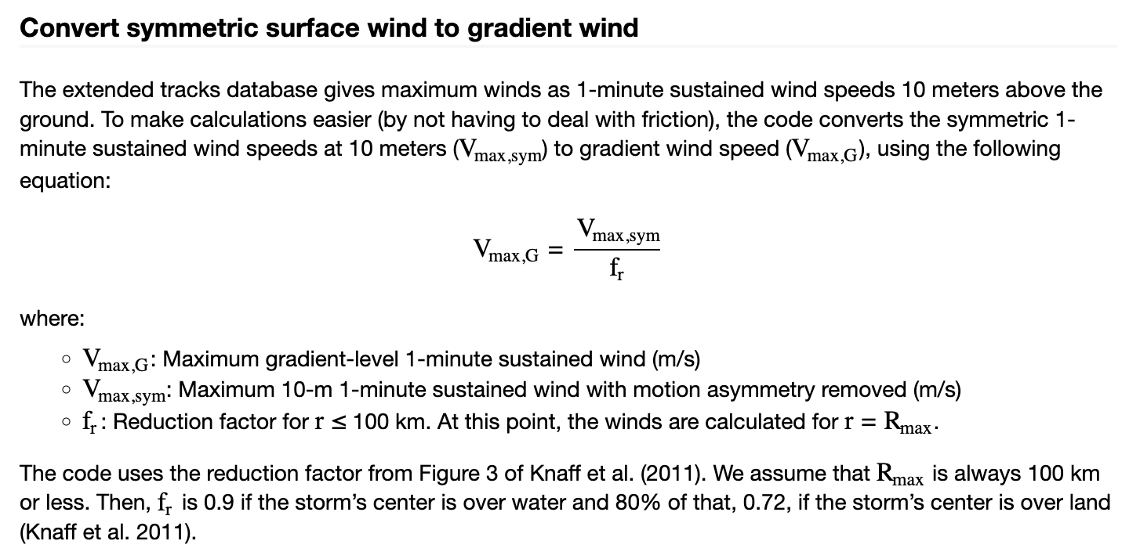

Slide 35

The tidy data format as an interface
General-use interface for data science
Source: R for Data Science, Wickham et al.

Slide 36
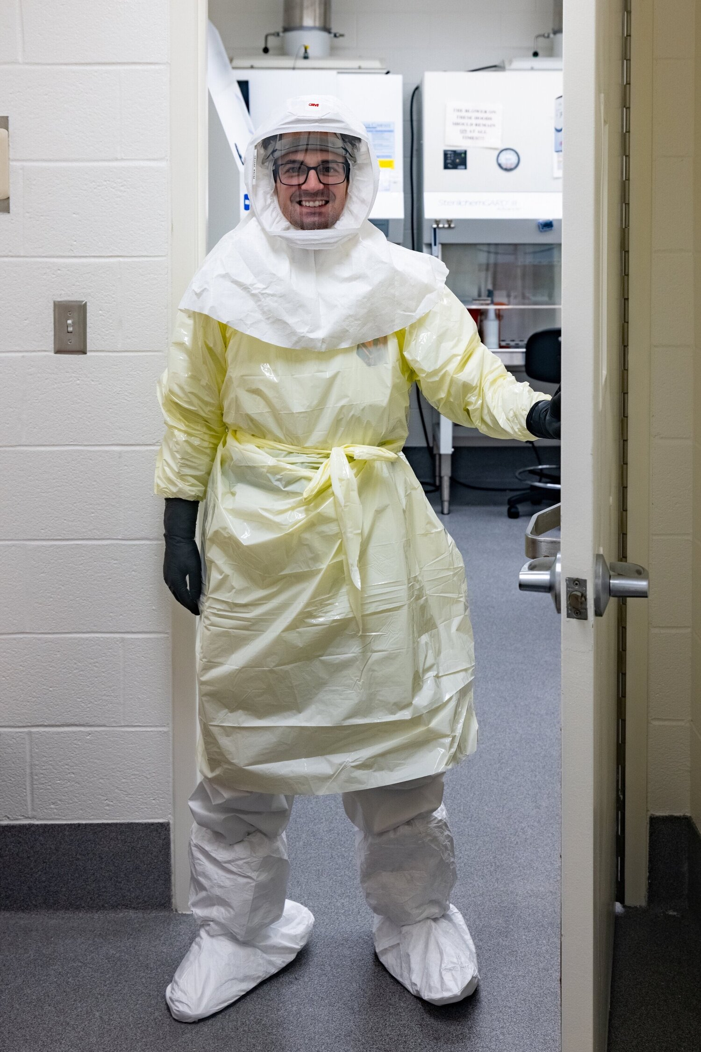
Immunology Interfaces
Tidy data format as an interface
A lot of the work is in a secure lab, creating added considerations when recording data
Most comfortable with spreadsheets for data recording
Open to changing data collection format, but need to be sure to not make it harder for them to collect data
Source: Jurado Lab, University of Pennsylvania

Slide 37
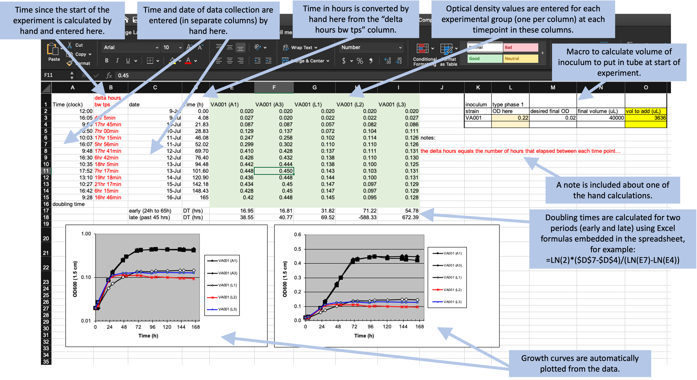

Slide 38
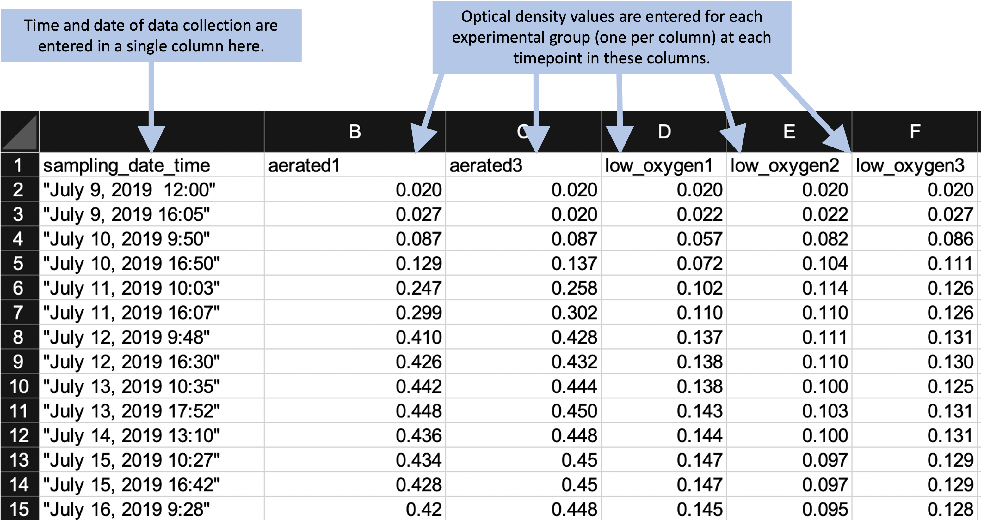

Slide 39
Tip #3: Pick up your pencil
Draw to observe. Draw to communicate.

Slide 40
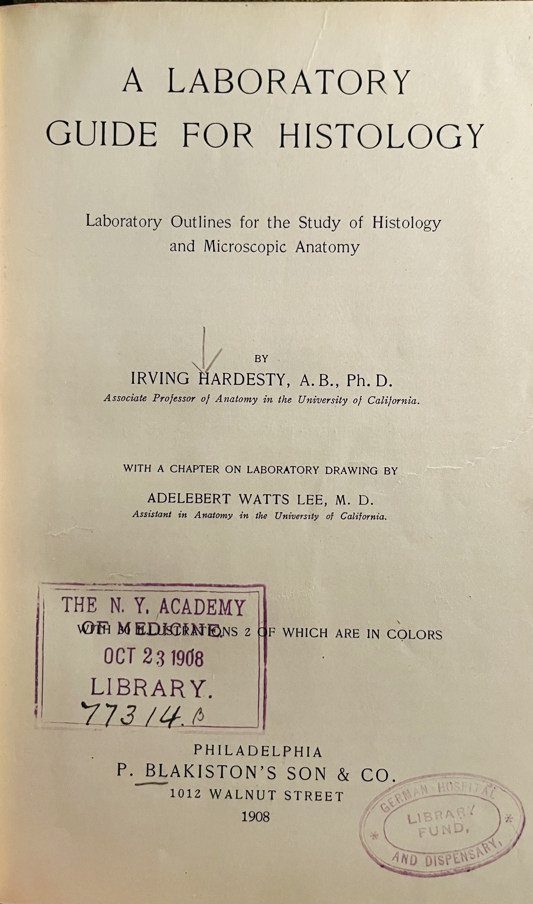
Drawing in the sciences
Histology laboratory class instructions, 1908
Required supplies for histology student:
Specific types of Bristol board
Drawing pencils in three hardnesses
Specific drawing pen-points and holder
India ink
Assorted color crayons
Small drawing board

Slide 41
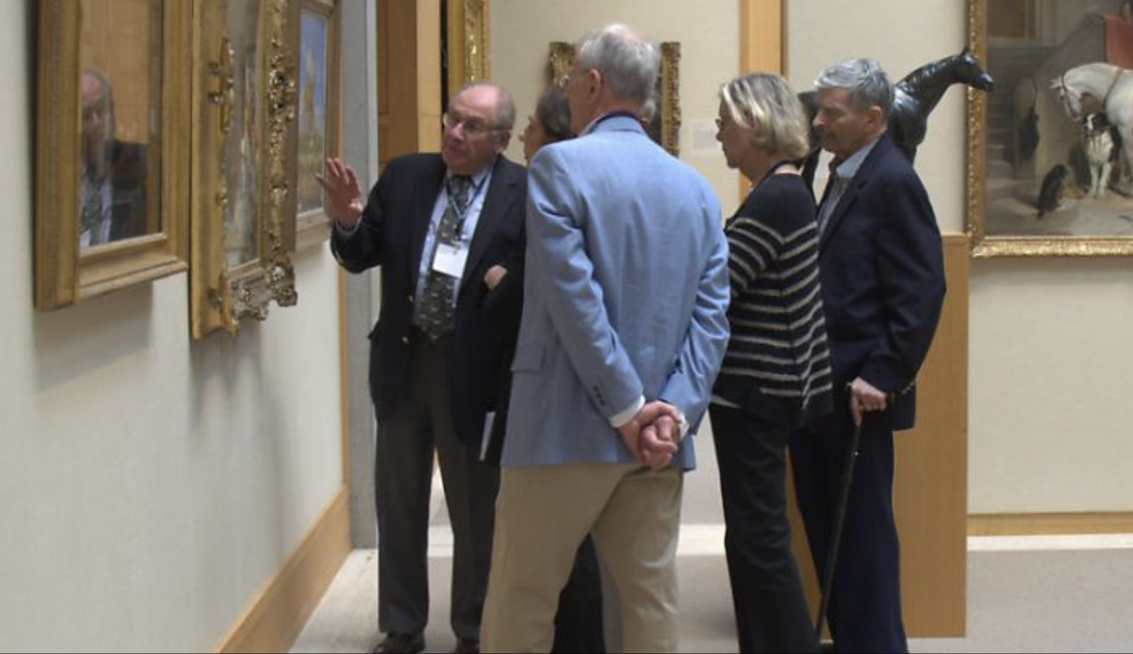
Learning to observe
Medical students in the museum
“Nearly every student who responded said that, though they had considered themselves to be adequate observers before the workshop, afterwards they realized they were looking at things superficially. The course had helped them learn to look at the world, and their patients, more in depth.”

Slide 42
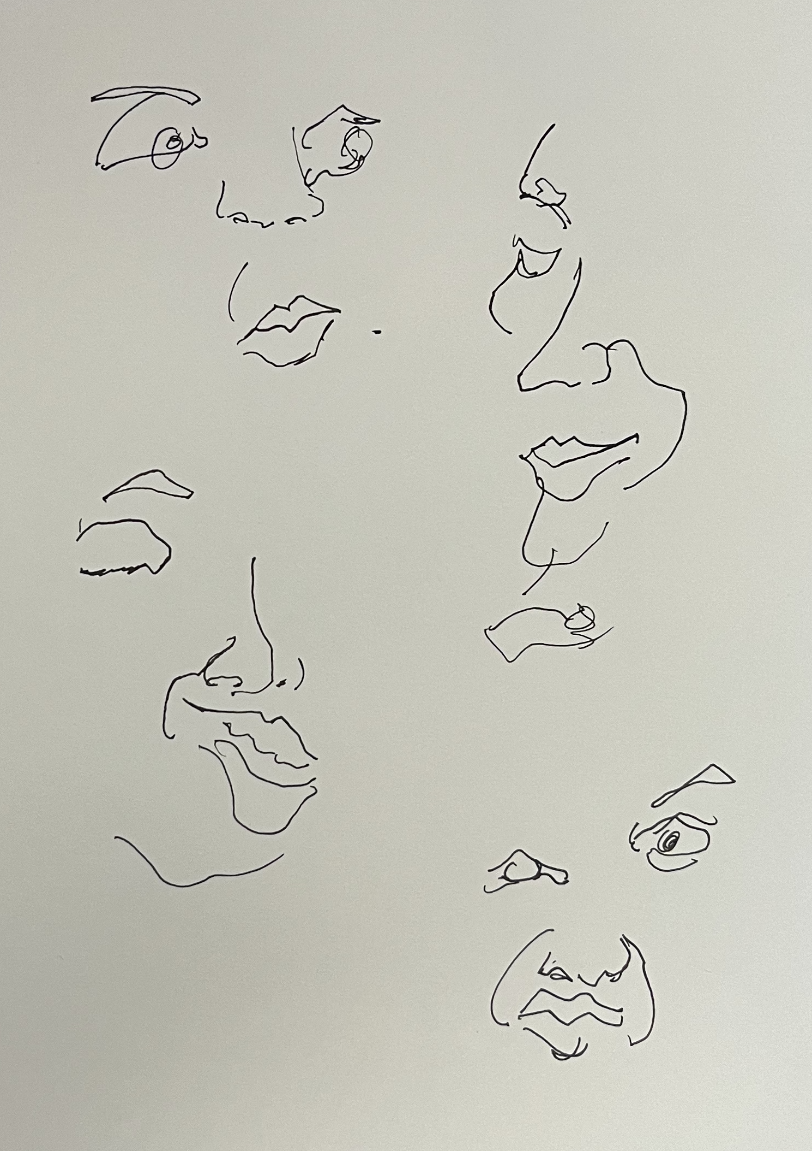
Drawing to observe
The process rather than the product
Blind contour drawings force you to focus on the subject, not what the drawing looks like
This is a way to learn about the subject, as it forces close observation of every part

Slide 43
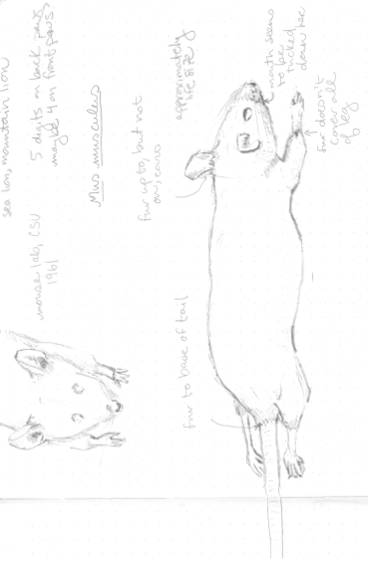

Slide 44
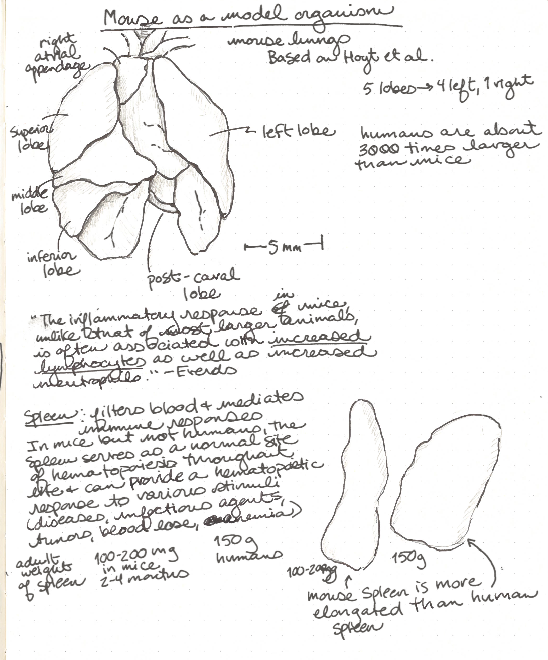
Drawing to understand
Immunology example
We are developing a pipeline to analyze data collected from mice
Different types of data are collected from different lobes of the lung as well as from the spleen

Slide 45
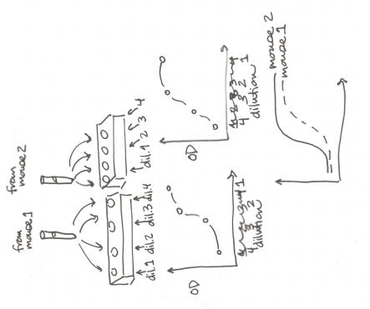
Drawing to communicate
Example from immunology
Developing a pipeline to analyze data on antibodies
Since we don’t know the exact targets, we can’t develop a standard curve
Drawing to communicate the process of collecting data on standard dilutions

Slide 46
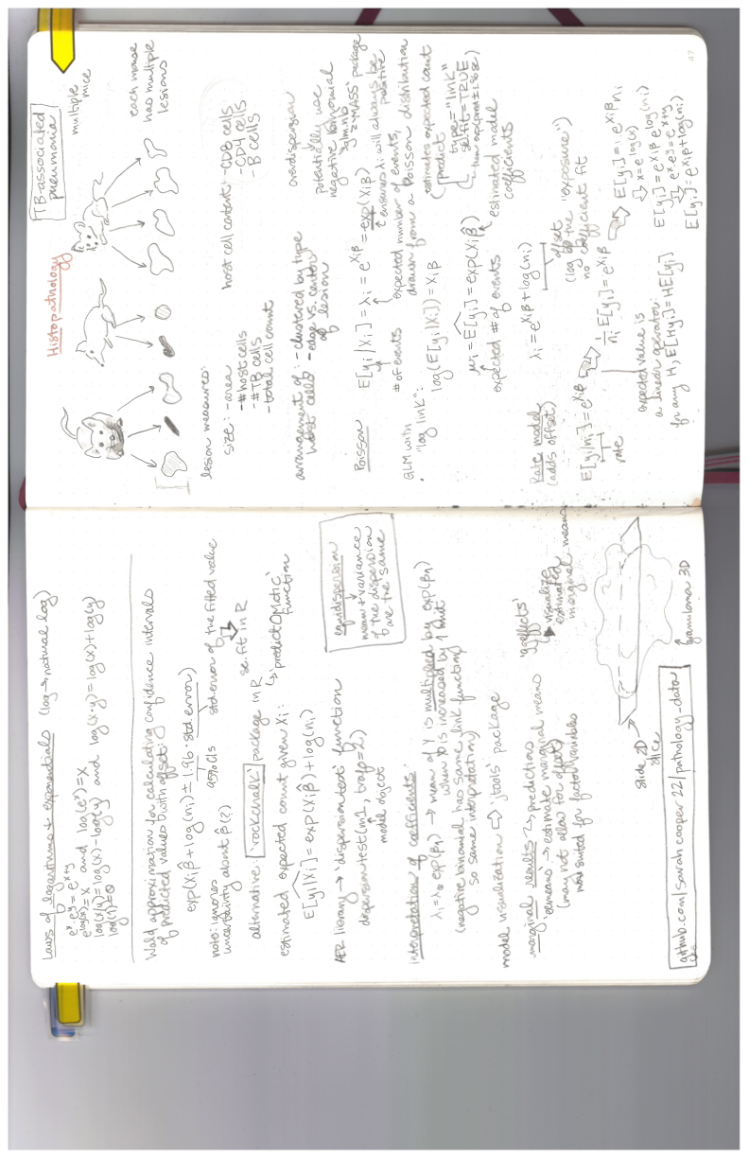

Slide 47





Slide 48
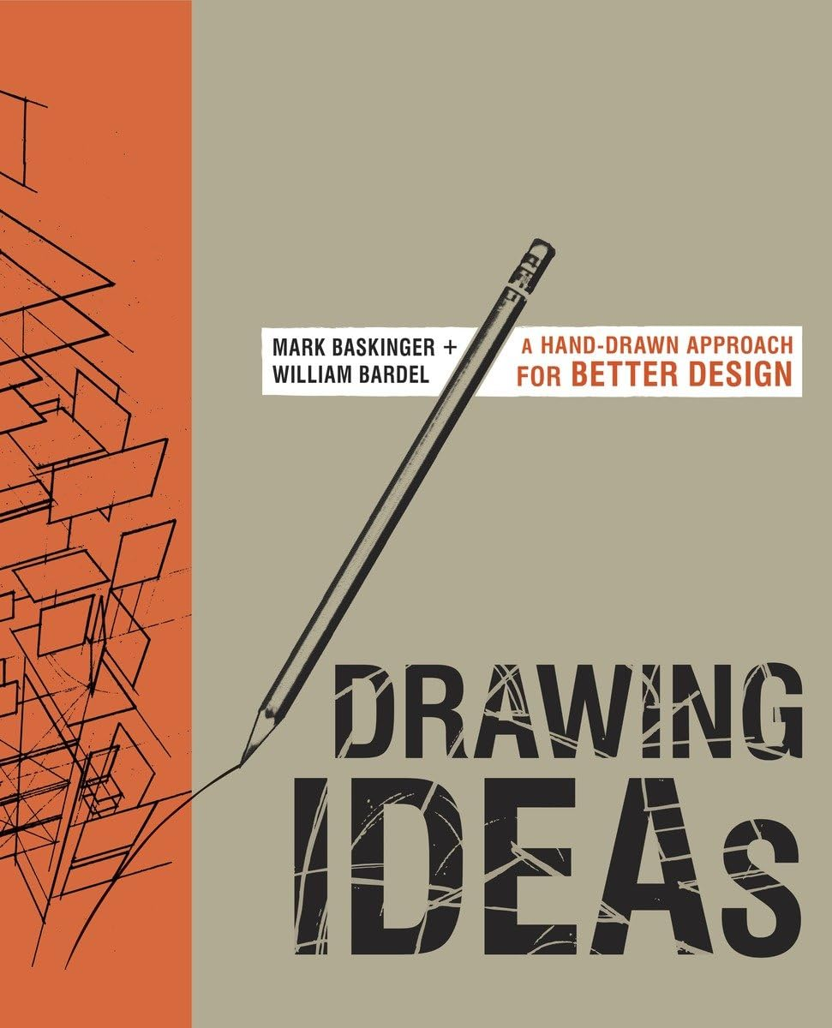
Drawing to communicate
Expanding your toolkit
Drawing processes and pipelines
Incorporating hand-drawn and pictorial elements in graphics

Slide 49
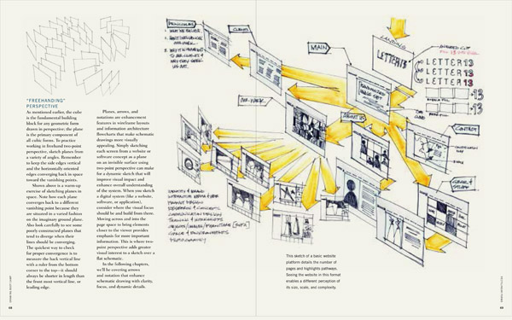
Source: Drawing Ideas, Baskinger and Bardel

Slide 50
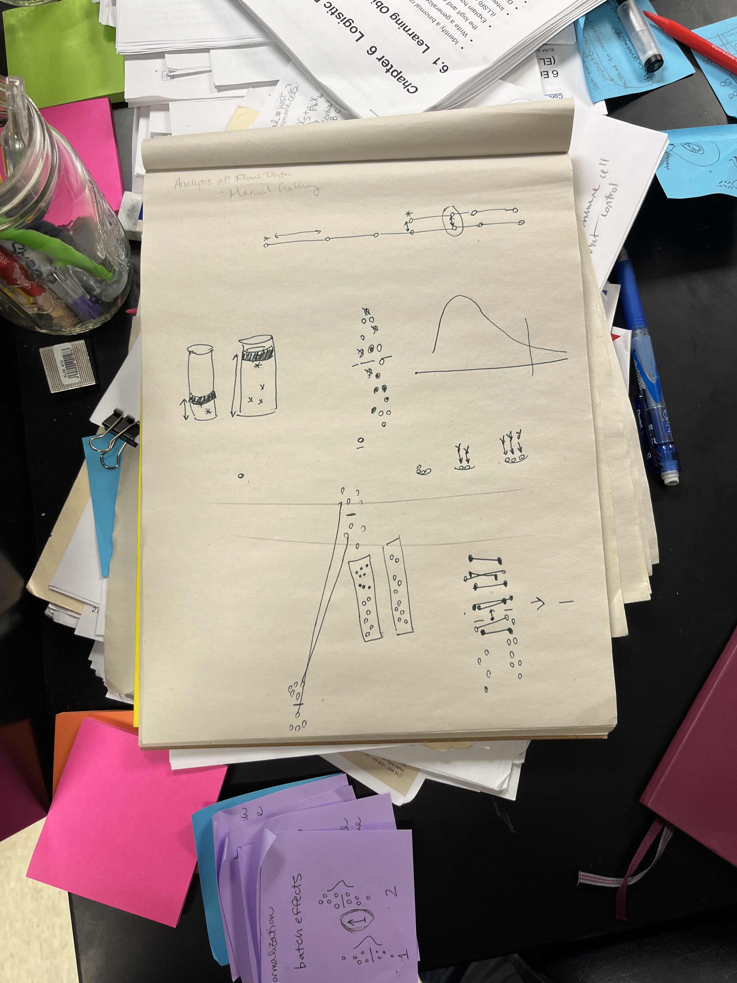
Drawing in the sciences
Prep your lab for collaboration
Our dry lab supplies include:
Pads of newsprints
Painter’s tape
Post-it notes
Variety of pencils, pens, and markers

Slide 51
Closing
The tolerance of ambiguity

Slide 52
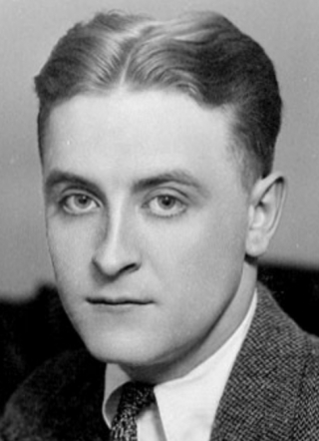
F. Scott Fitzgerald
“The crack-up”, esquire magazine
“The test of a first-rate intelligence is the ability to hold two opposing ideas in mind at the same time and still retain the ability to function. One should, for example, be able to see that things are hopeless yet be determined to make them otherwise.”

Slide 53
Richard Hamming
“You and Your Research”
“Great people can tolerate ambiguity; they can both believe and disbelieve at the same time. You must be able to believe your organization and field of research is the best there is, but also that there is much room for improvement. …
I have not the faintest idea of how to teach the tolerance of ambiguity, both belief and disbelief at the same time, but great people do it all the time.”

